Slide 1
Azure Community Conference 2021

Slide 2



Gold Partner
Venue Partner
Learning Partner

Slide 3




Sriram Ganesan
Architect- Cloud Transformation & Engineering at Virtusa Consulting Services Ltd
https://www.linkedin.com/in/sriram-ganesan-it/
https://ramsaztechbytes.in/
@ArchNomad87 ( https://github.com/gsriramit)

Slide 4
Unified Governance of AKS through Gatekeeper and Azure Policies
Governance Implementation for AKS through Azure Policies

Slide 5
Agenda
Cloud Governance
Admission Controller in K8s
Comparison with an ASP.Net Request Pipeline
Validating Controllers
Application in Pod Security & Resiliency Policies
Introduction to OPA & Rego
Introduction to Governance through Azure Policies
OPA + Gatekeeper with Azure Policies for AKS
Architecture explanation
Anatomy of the OPA components baked into Azure Policies
Examples of Pod security and resiliency policies
Application of the AKS policies at Enterprise Scale
Extension to Arc-Enabled Kubernetes and Azure Kubernetes Engine
Demo
Take-away for DevSecOps and Developers
Alternate tools – Checkov
References

Slide 6
Cloud Governance
Cloud governance is a set of rules and policies adopted by companies that run services in the cloud. The goal of cloud governance is to enhance data security, manage risk, and enable the smooth operation of cloud systems.
Definition taken from Imperva.com

Slide 7
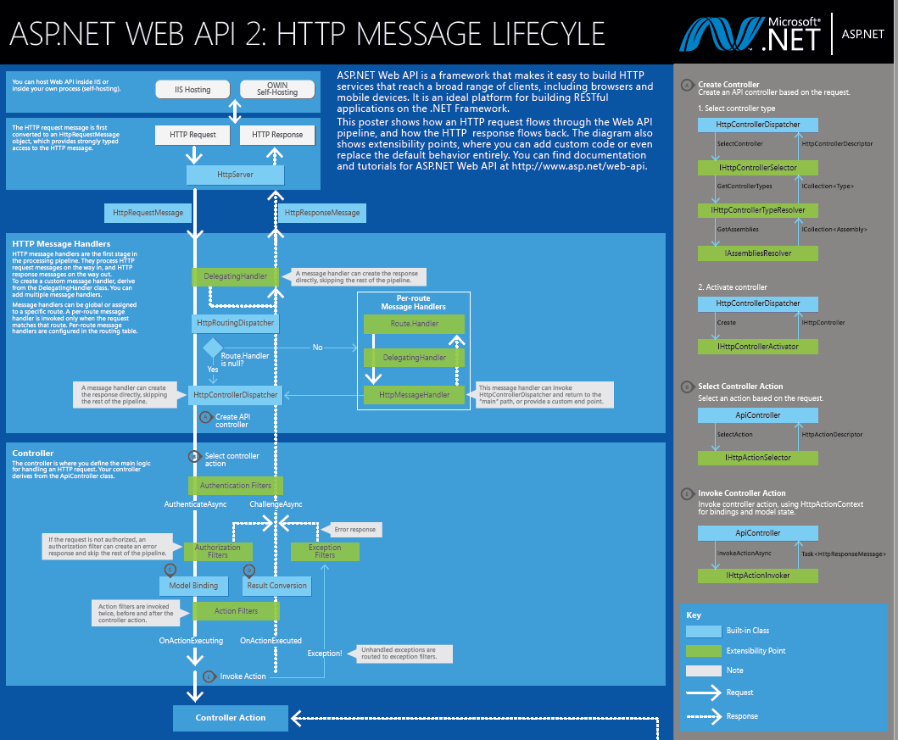
Components in an ASP.NET Request Pipeline

Slide 8
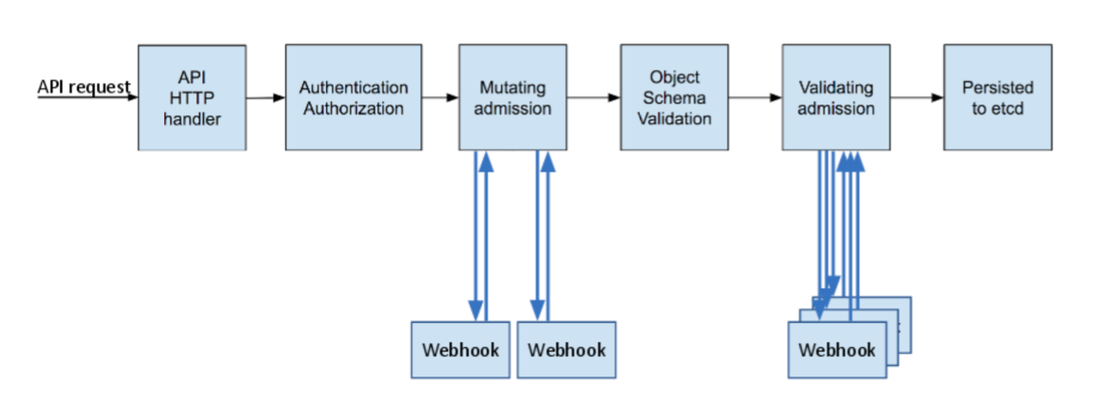
Admission Controllers in Kubernetes
Src: https://kubernetes.io/blog/2019/03/21/a-guide-to-kubernetes-admission-controllers/#what-are-kubernetes-admission-controllers

Slide 9

Validating Controllers for Pod Security & Resiliency
Security Policies
Enforcing security context of the pods and containers
Container security and vulnerability prevention measures
Learnings from
Public Cloud Security Communities and
General Linux Security controls
Reliability Policies
AKS Nodes
Distribution across availability zones
Pod Reliability
Minimum number of replicas
Pod Topology Spread Constraints
Pod Disruption Budgets

Slide 10
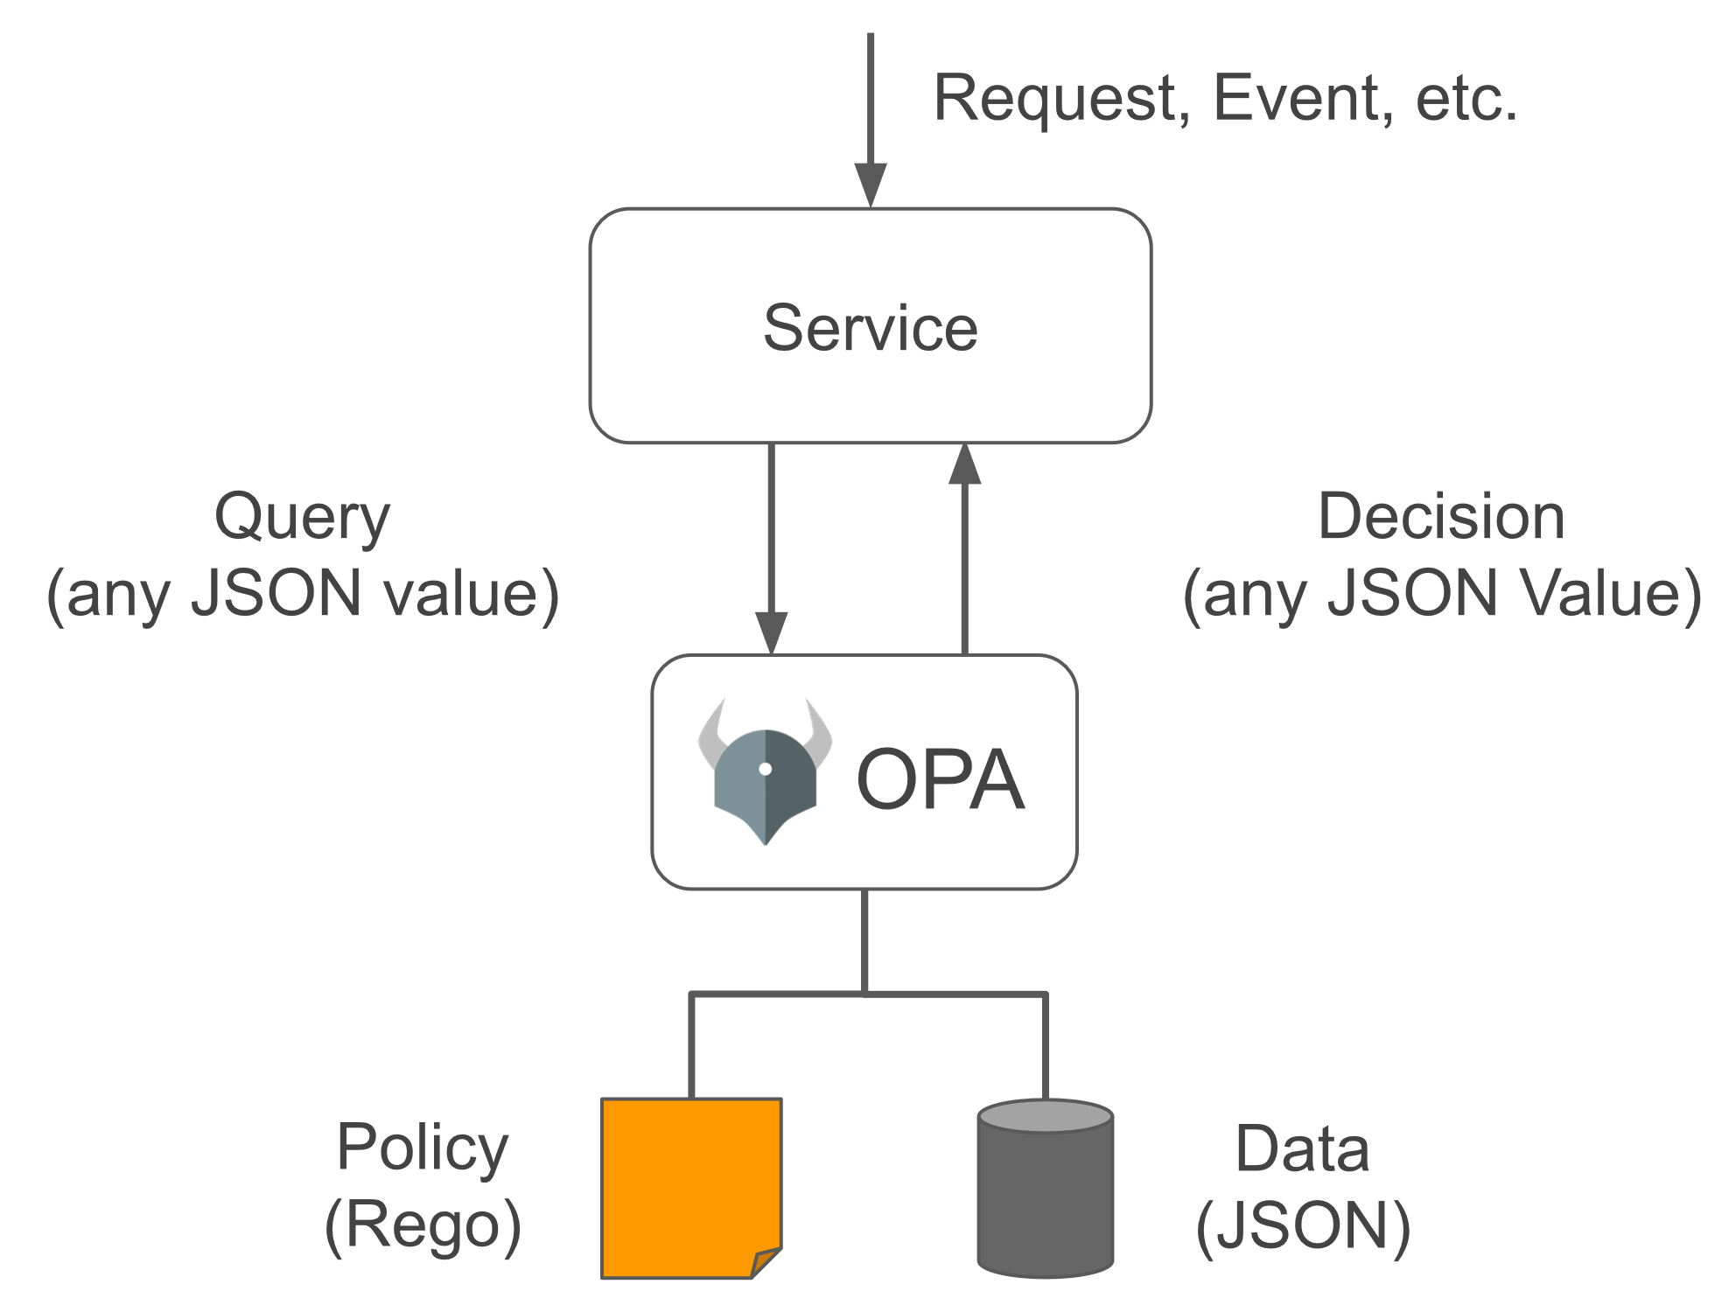
Introduction to OPA, Rego & Azure Policies
Azure Policies
Azure Native Policy as code
Evaluates resources in Azure by comparing the properties of those resources to business rules
Applied across scopes in Resource Entity Hierarchy
helps to enforce organizational standards and to assess compliance at-scale
OPA –Open Policy Agent
Open source, general-purpose policy engine
High-level declarative language that lets you specify policy as code
Applied in microservices, Kubernetes, CI/CD pipelines, API gateways, and more
REGO
OPA policies expressed in a high-level declarative language
Purpose-built to express policies over complex hierarchical data structures.
Note: Definitions are taken from the OPA official website- https://www.openpolicyagent.org/docs/latest/ &
https://docs.microsoft.com/en-us/azure/governance/policy/overview

Slide 11
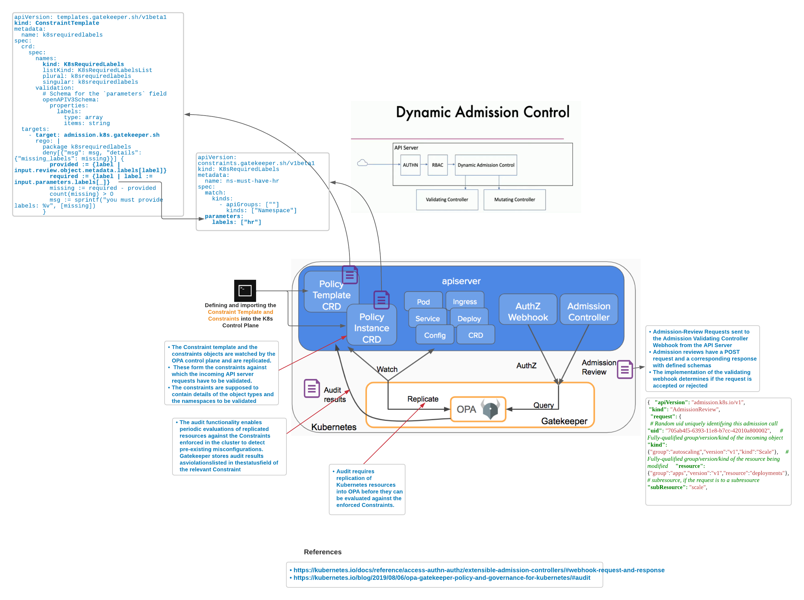
OPA + Gatekeeper with Azure Policies for AKS- Architecture

Slide 12
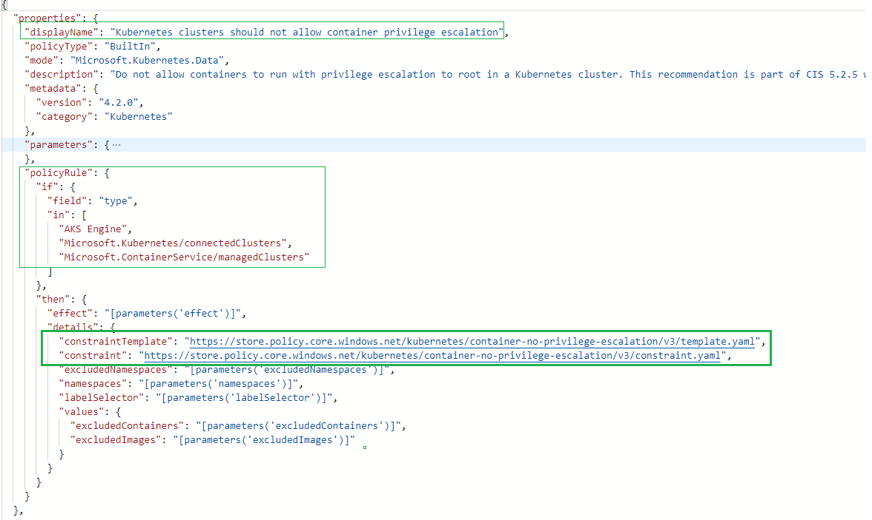
OPA + Gatekeeper with Azure Policies for AKS- Anatomy
https://store.policy.core.windows.net/kubernetes/container-no-privilege-escalation/v3/template.yaml
https://store.policy.core.windows.net/kubernetes/container-no-privilege-escalation/v3/constraint.yaml

Slide 13
Security Policies and Extensions for reliability

Slide 14
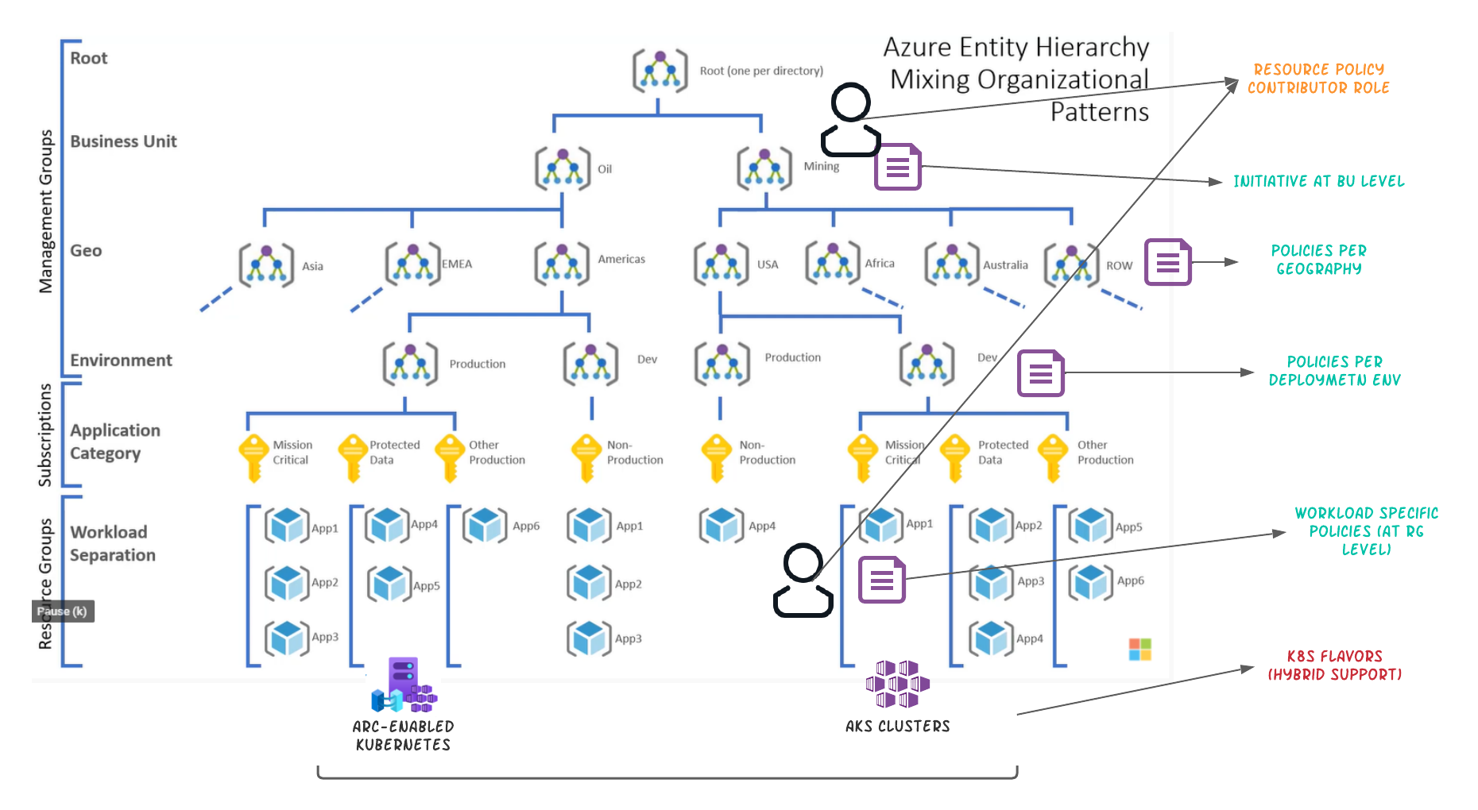
Application of Kubernetes policies at Enterprise Scale

Slide 15
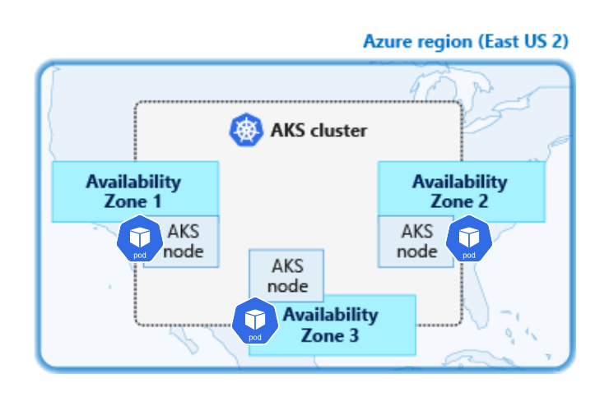
Pod Topology Spread Constraint demo

Slide 16
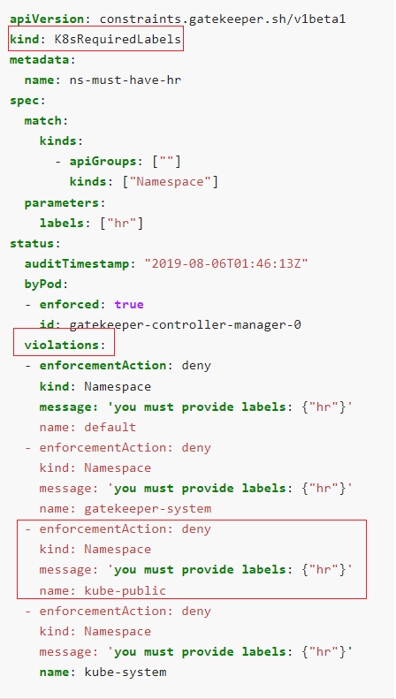
Takeaway for Dev and DevSecOps
Audit logs from the evaluation of these policies can be pushed to the log analytics workspace to further analyze the "Kubernetes security maturity" of the team and also improve the SSDLC (Secure Software Development Lifecycle) processes
Integration of the policies to enforce security & reliability during the CD stage of kubernetes - <Architecture>
Reusable policies and library functions (for security and otherwise) that can be used across the organization without much of rework

Slide 17
References
Video References
Introduction to the OPA & Gatekeeper for K8s Project
https://www.youtube.com/watch?v=Yup1FUc2Qn0&ab_channel=CNCF%5BCloudNativeComputingFoundation%5D
Working of Gatekeeper explained
https://www.youtube.com/watch?v=6Kur5MXg7us&ab_channel=CNCF%5BCloudNativeComputingFoundation%5D
Demonstration of Rego playground
https://www.youtube.com/watch?v=nzcnf83NvxE&ab_channel=OpenPolicyAgent
Gatekeeper source code repository
https://github.com/open-policy-agent/gatekeeper
Developing OPA policies using VS-Code and compiler for local development and testing
VS code- https://marketplace.visualstudio.com/items?itemName=tsandall.opa
Rego Playground- https://play.openpolicyagent.org/
REGO Language Reference - https://www.openpolicyagent.org/docs/v0.12.2/language-reference/
REGO Language Cheat sheet - https://www.openpolicyagent.org/docs/v0.12.2/language-cheatsheet/

Slide 18




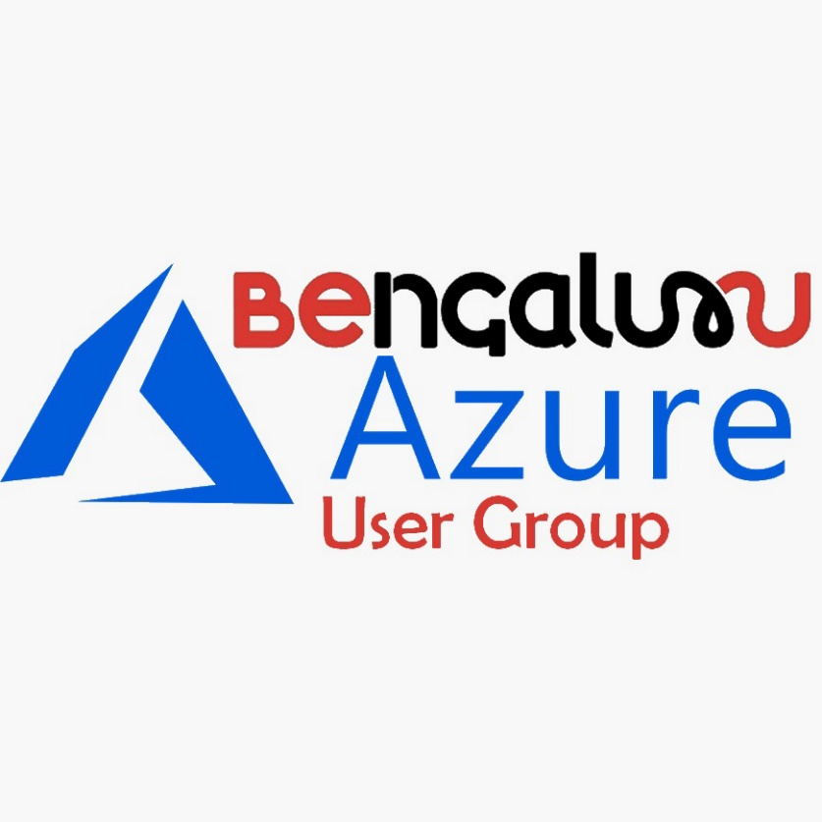
Azure Communities

Slide 19
Q & A

Slide 20
Feedback

Slide 21
THANK YOU!

